Slide 1
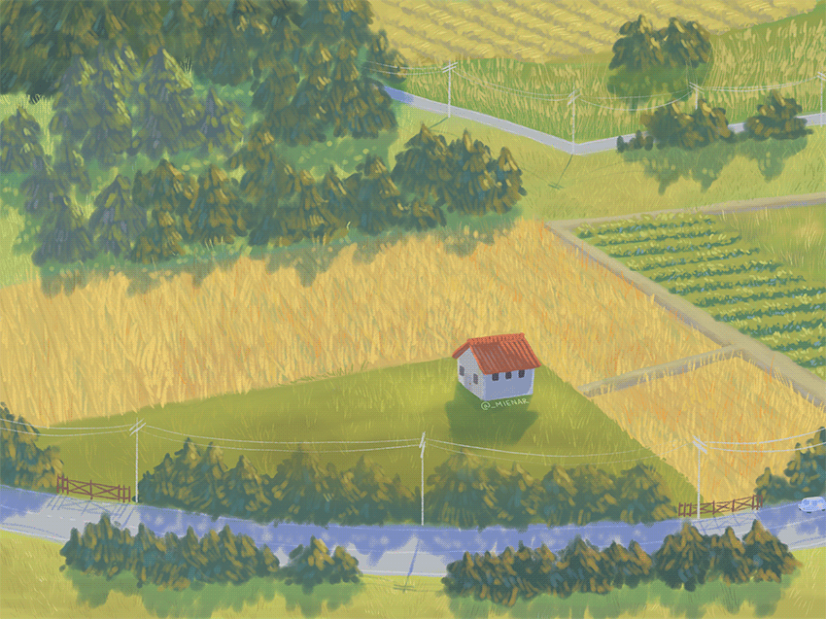

It is a usual day in the life of our farmer..
He has many vegetable fields grown across the countryside..

Slide 2
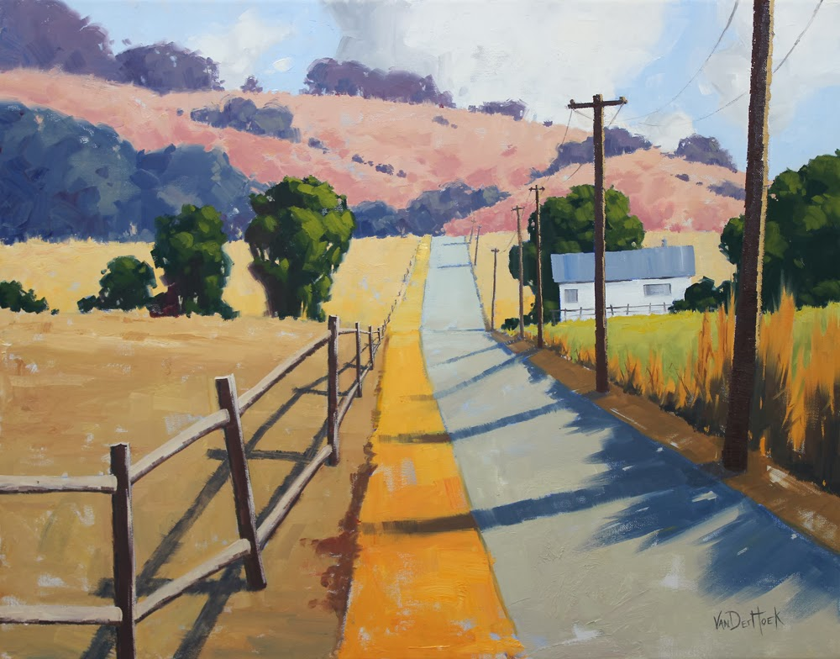
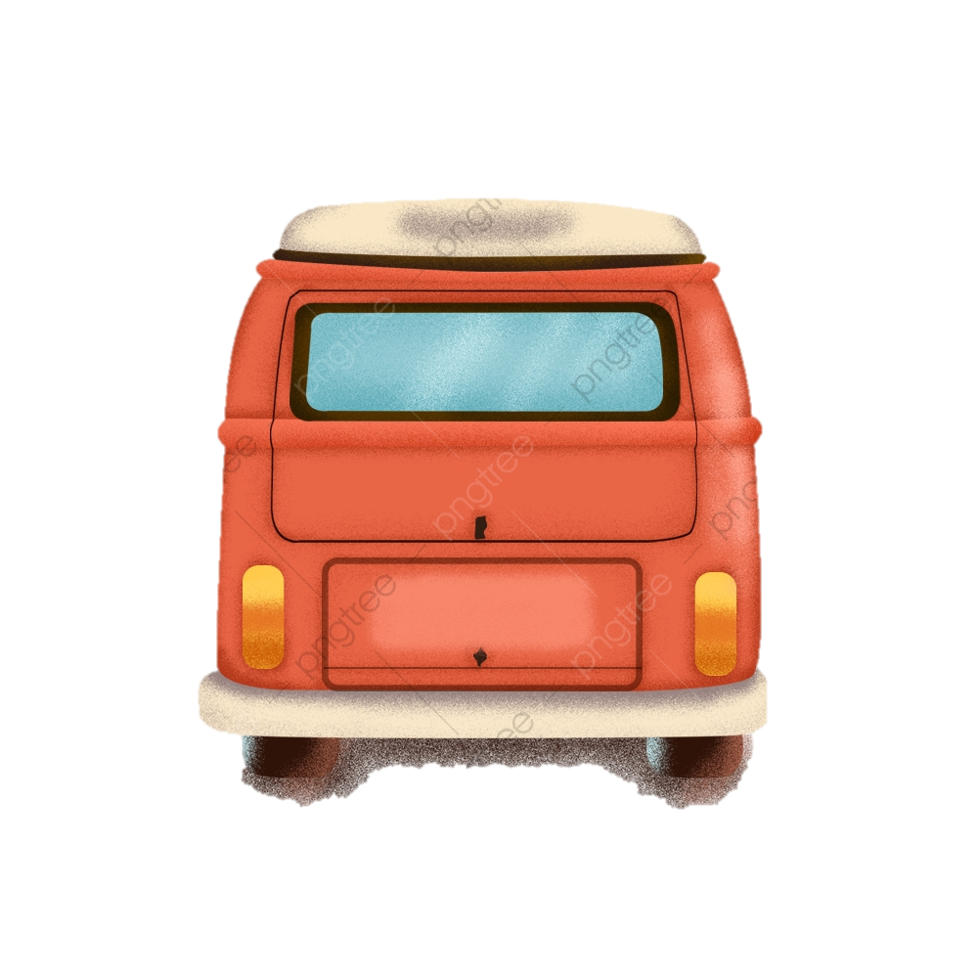
Each day, the farmer drives all the way to his fields to check up on them..
While driving, a million questions arise in his mind..

Slide 3

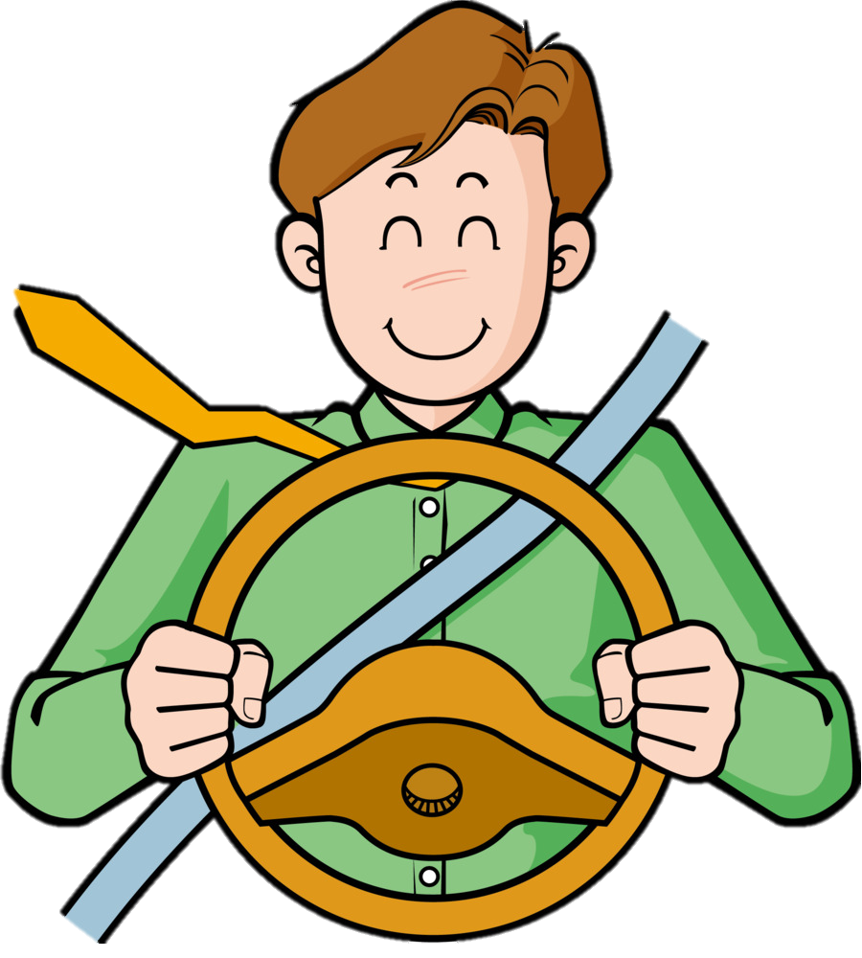

I must remember to spray the potatoe fields with insecticides
I wonder what‘s happening in the tomato fields…
I‘m definitely forgetting something important….
I wonder which fields there are nearby…?

Slide 4
Dejected, he makes a wish..

Slide 5
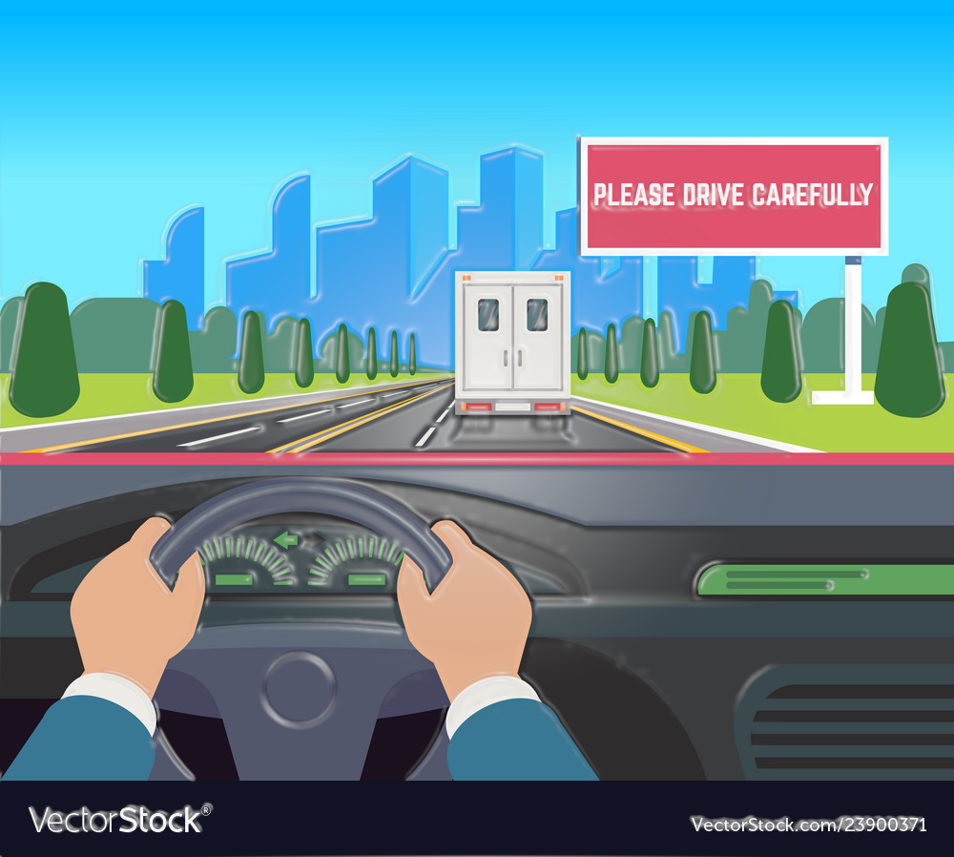









If only there was some app that could track all my thoughts and help me manage my tasks…

Slide 6


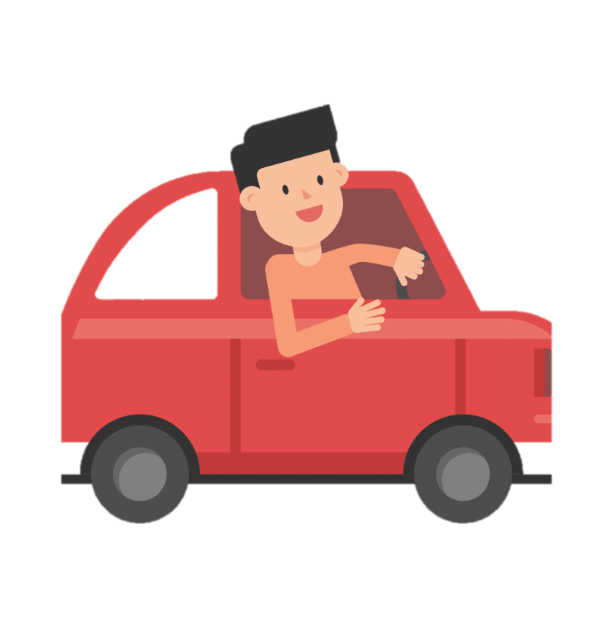




JD Farmer
Drive Safe, While Connected

Slide 7


We have an App for you!
Read Notes
Take Notes
Get Field Updates
Show Nearby Fields
Receive Notifications
Get Field Flag

Slide 8
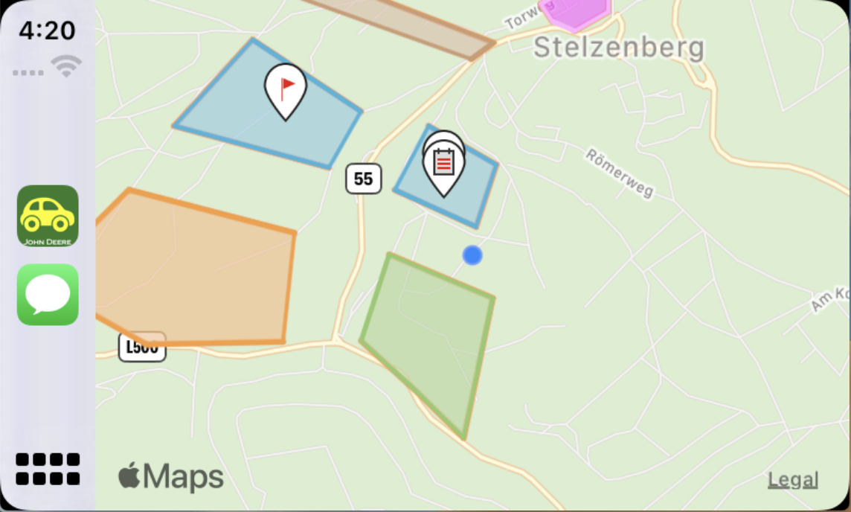

Bring your office to your car!

Slide 9
